Slide 1
VI Guidelines
For better application of the DFI brand

Slide 2




VI Elements Summary
These are the basic elements that form DFI‘s Visual Identity. By correctly reproducing these elements according to the display and development rules as follows, we can express a consistent world view of DFI.
Brand Logo
Brand Logo with Slogan
Headquarters Official Company Name Logotype
Slogan

Slide 3

Brand Logo Display
We recommend displaying the brand logo in DFI turquoise on a white background, or in white on a DFI turquoise background. When displaying in a single color, use black. When the background is a dark color, use white.

Slide 4
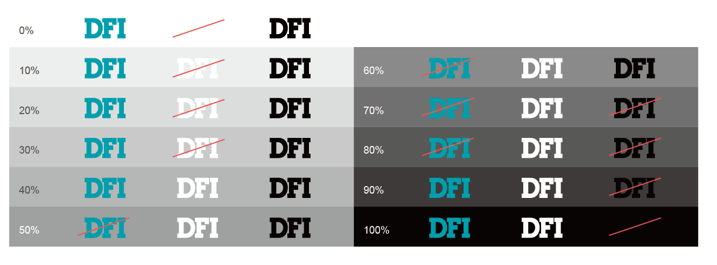
Brand Logo - Background and Display Colors
The following guide shows the concept when dealing with brand logo display on various background colors
(including those other than shown). Follow these examples and try to ensure the visibility of the brand logo.

Slide 5
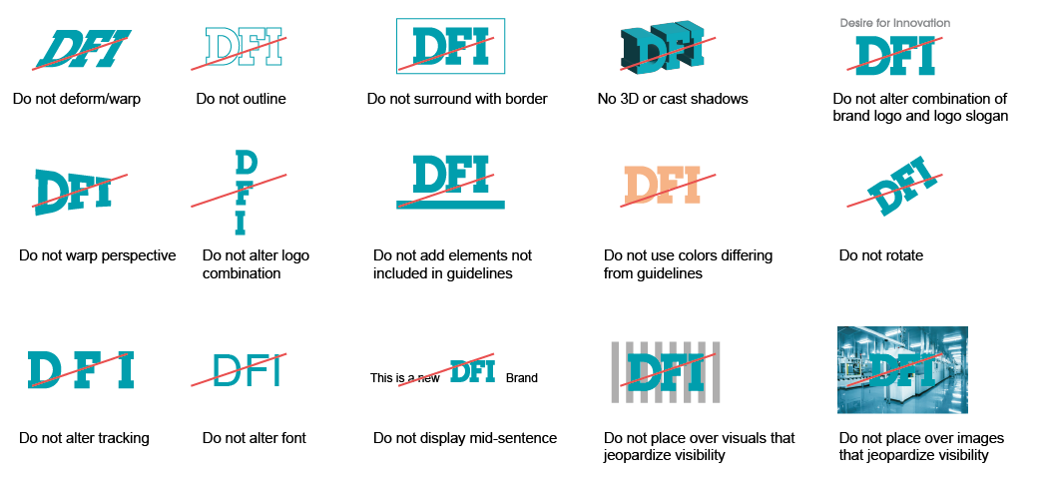
Brand Logo - Non-Examples
The following are non-examples of the brand logo that show common mistakes. Please follow the display rules and strive to reproduce the logo correctly.

Slide 6
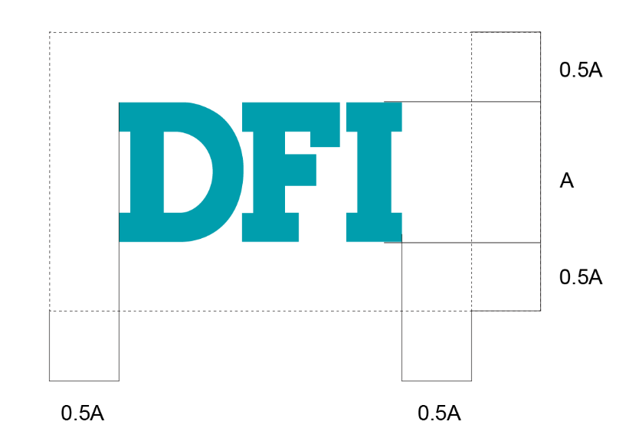

Brand Logo - Clear Space & Minimum Size
The protective area is the clear space that always surrounds our logo. It ensures that our logo is distinct and never lost among other elements in its vicinity. Always ensure that the protective area is free from graphic elements and typography.
Clear Space
Minimum Size

Slide 7
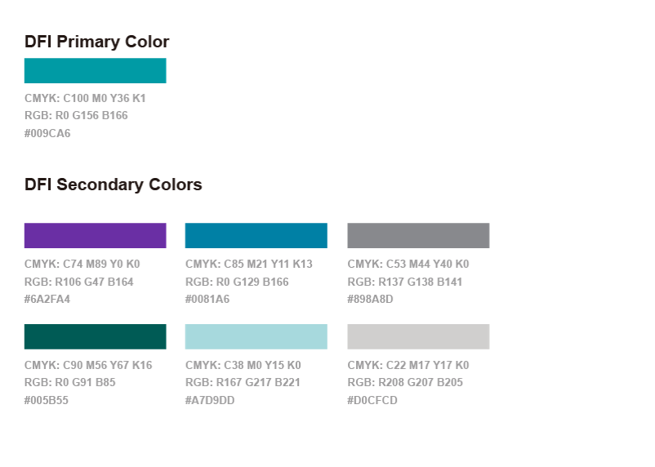
Brand Colors
Brand color is an important element of visual identity. DFI turquoise is the most important color in the DFI brand.
Secondary colors used as colors that bring out DFI turquoise. Strive to maintain a consistent color scheme.

Slide 8
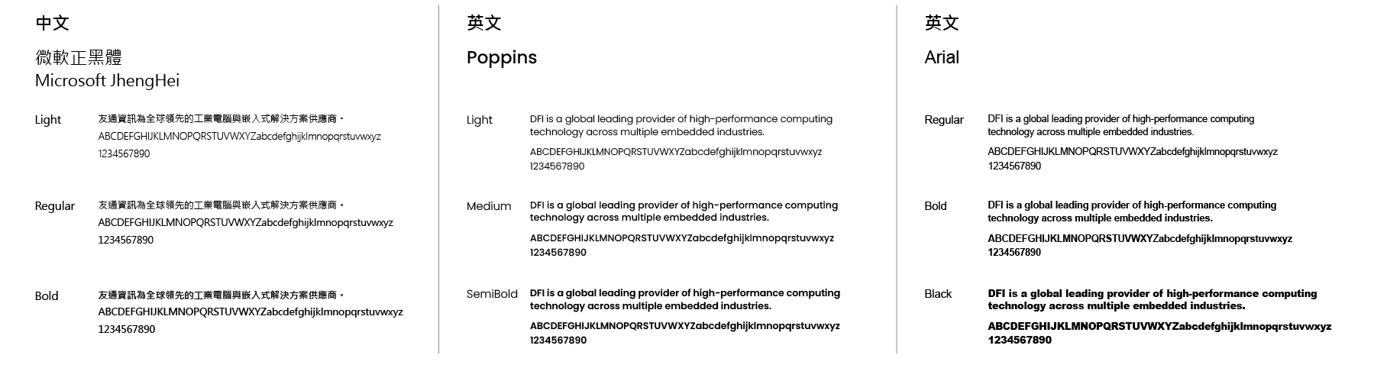
Character Set
When displaying characters, use the recommended typefaces.

Slide 9
Thank you!

